Slide 1

Using Visual Studio Tools for Apache Cordova to Create Multi-Platform Applications
Kevin Ford
Mobile Practice Lead,
Magenic

Slide 2
kevinf@magenic.com
@Bowman74
http://windingroadway.blogspot.com/
https://github.com/Bowman74
Kevin Ford

Slide 3
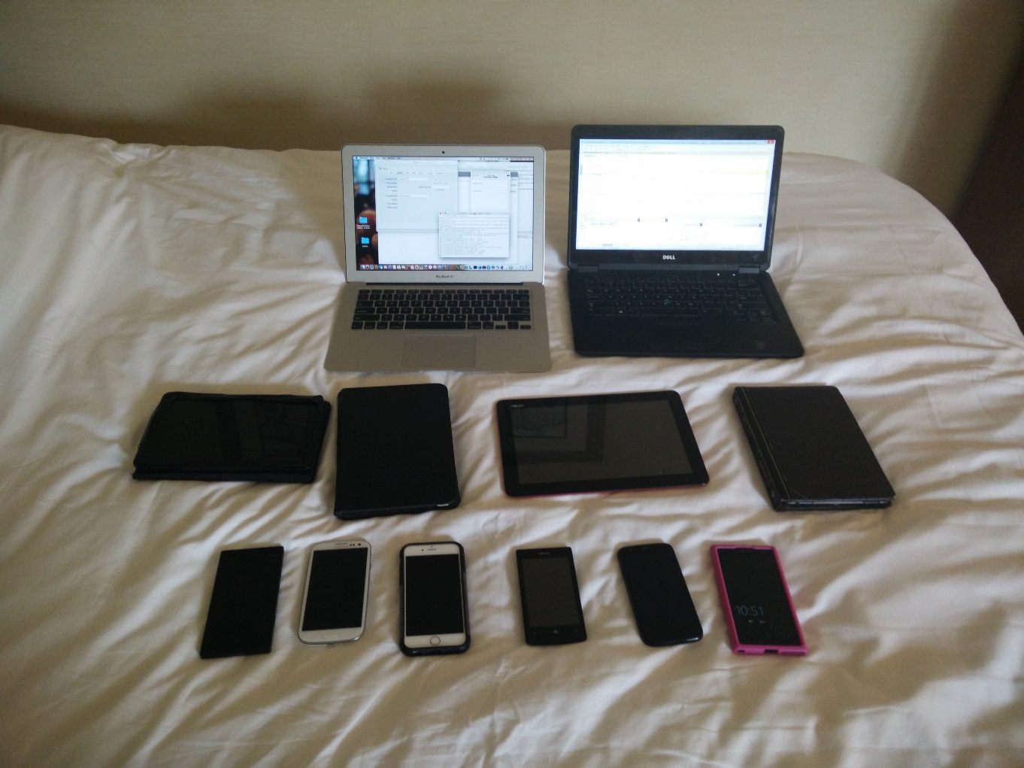
Notes:
Mobile Developers work with a wide variety of apps

Slide 4

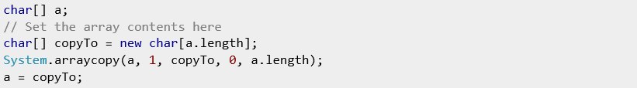
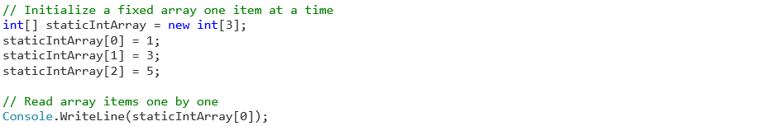
The Mobile Development Problem
iOS
Objective-C/Swift/Xcode
Android
Java/Android XML
WinRT
C# .NET/XAML
C++/XAML
Html5/JS
Windows Phone
C# .NET/XAML
C++/XAML
Html5/JS
4

Slide 5
Development Options
Mobile Enabled Web
Hybrid
True
Native
Near Native
HTML5/JS
Cordova
Xamarin
Java-Android
Objective-C /iOS
Notes:
Generally the closer to native you get the better the potential user experience
Tools like Xamarin use native UI technologies and generally offer day one support for most new features
However, many tools are made for “true” native technologies, such as tools that wrap apks may work better with true native technologies
True native technologies represent the OS creator’s preferred way of writing applications for the OS
True native tools are free

Slide 6
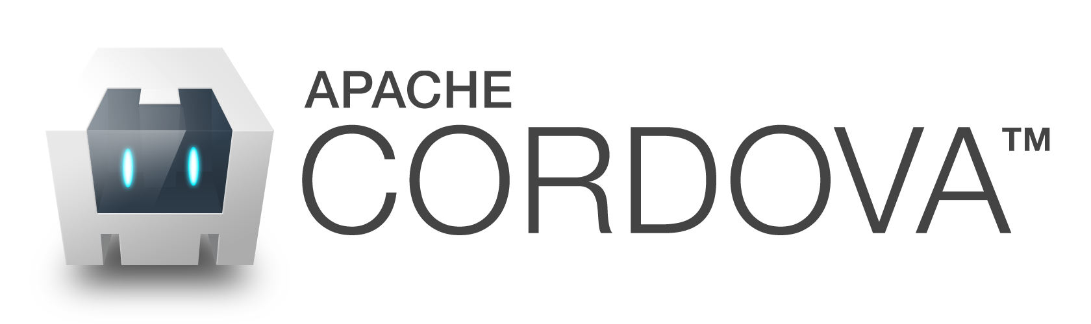
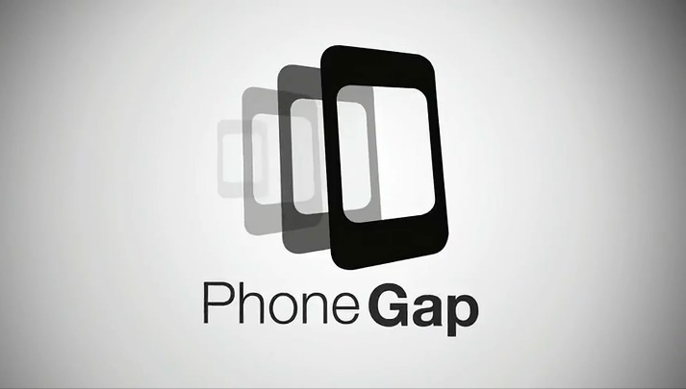

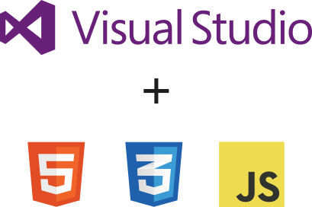
What is
Notes:
Javascript/css/html framework that runs in a native wrapper on a device.
Cordova is open source
Other frameworks built off of it like Telerik’s AppBuilder, PhoneGap and of course VS tools for Cordova
Generally all the same except for elements of the application structure
There are also extra services such as PhoneGap’s build service in the cloud.

Slide 7
How does Cordova Work?
Android Native Container
iOS Native Container
webview
HTML5 App
UIWebView
HTML5 App
HTML5 App
Plugin Interfaces
Plugin Interfaces
Plugin Interfaces
Plugin Implementation (Java)
Plugin Implementation (Obj-C)
Cordova Framework / SDK (Java)
Cordova Framework / SDK (Obj-C)

Slide 8


Supported Platforms?
Notes:
Android 2.3.3 and later (4.4 provides the best developer experience)
iOS 6, 7, and 8
Windows 8 and 8.1
Windows Phone 8 and 8.
Windows Universal

Slide 9





What do I need?
Notes:
This stuff is installed for you.

Slide 10
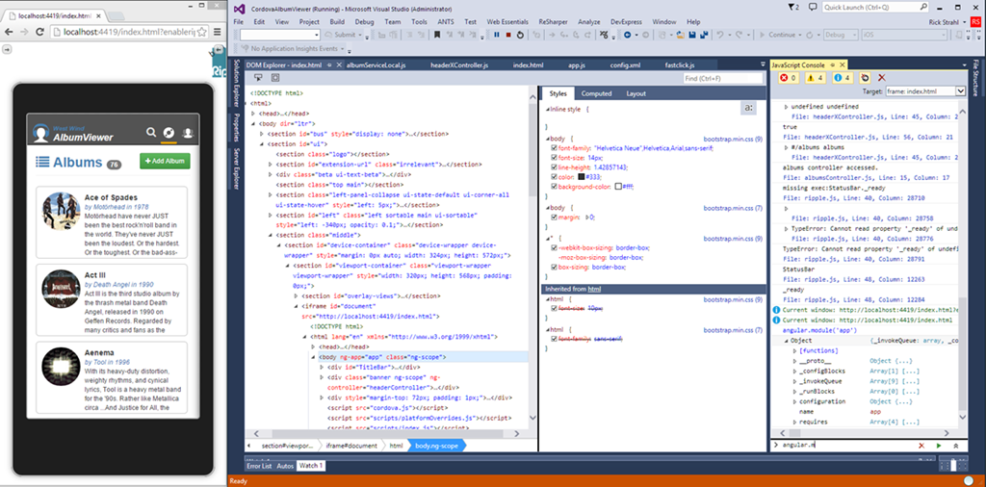
Emulator Options - Ripple

Slide 11
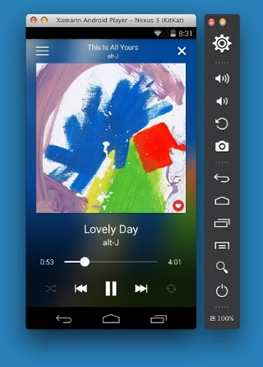
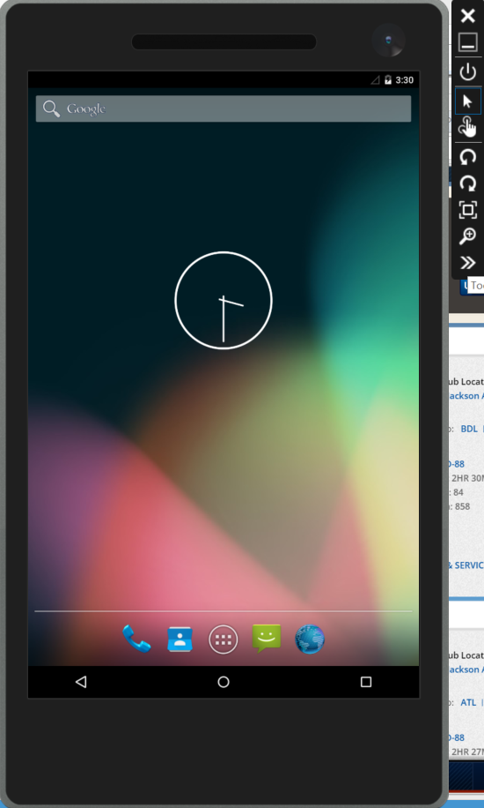
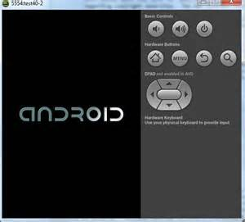
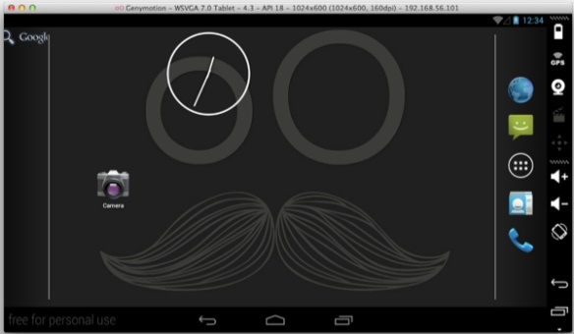
Emulator Options - Android

Slide 12
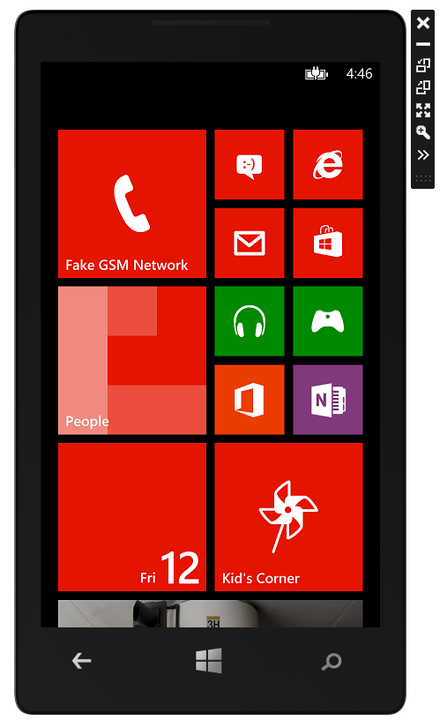
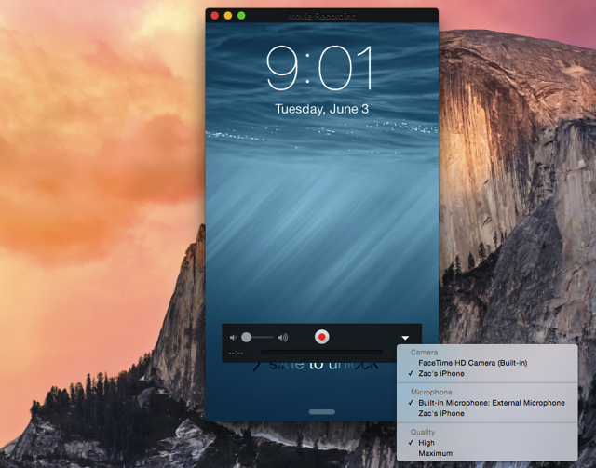
iOS and Windows Phone

Slide 13
Demo 1 : Creating a Project

Slide 14

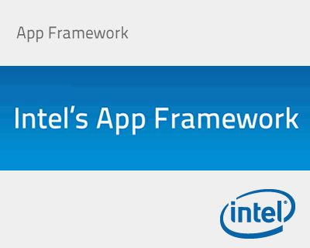







What about the UI?

Slide 15
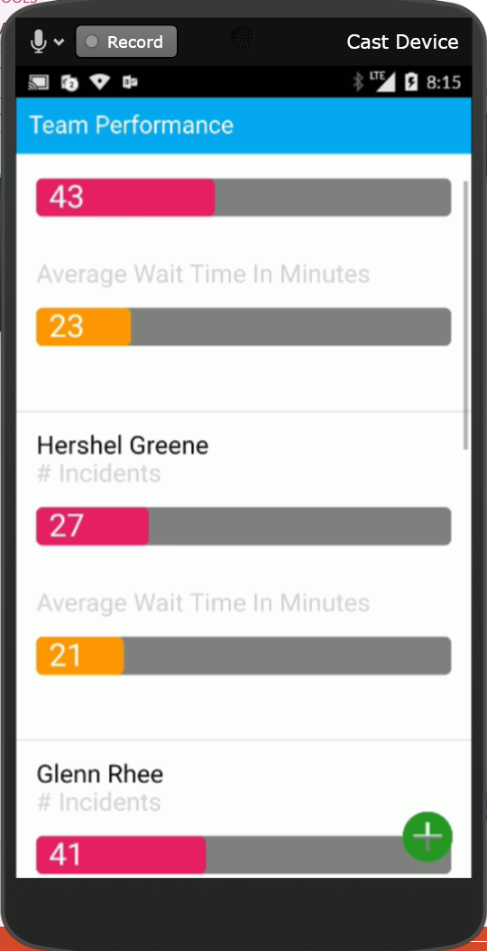
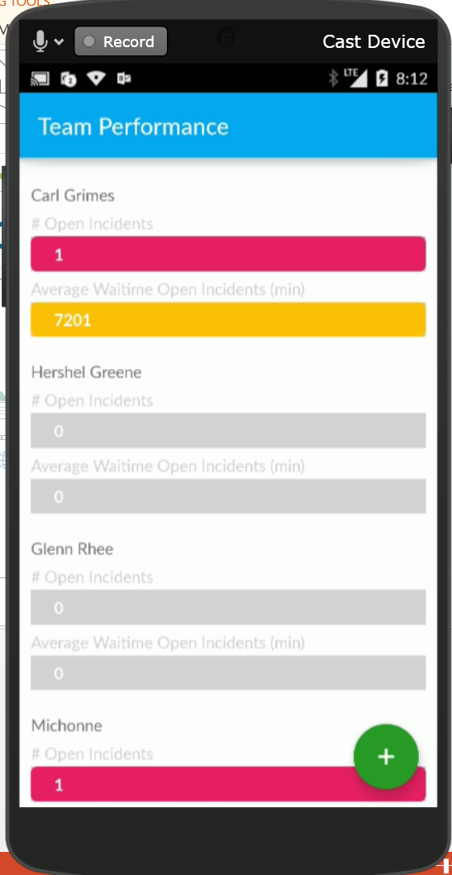
A Tale of Two Apps

Slide 16
Adding an UI Framework

Slide 17
Creating a Page
Basic Structure
Container
<div class=“view">
</div>
Pages
<div class=“pages">
<!-- panels go here -->
</div>

Slide 18
Creating a Page
Panels
<div id="pnlMainMenu" data-title="Cordova App" class="panel" selected="true" style="height: 100%">
Hello World
</div>
List
<ul class="list" id="lstMenuItems" style="width: 100%; height: 100%">
<li>First Item</li>
<li>Second Item</li>
</ul>

Slide 19
Basic Navigation
What you need to send
ID - id of the div to load (can be an Ajax URL)
New Tab - Boolean if you want to reset the history (new tab)
Go back - is this initiating a back transition
Transition - the name of the transition you want to show
Command:
$.afui.loadContent(_div_id,newTab,goBack,transition);
Or
<a href="#pnlGetMaxPrime">Max Primes</a>

Slide 20

What’s a Double-Click?
No clicks on mobile devices
HTML is designed for a .3 second delay in case of double-click
Use FastClick

Slide 21
Demo 2 : Adding a UI Framework

Slide 22
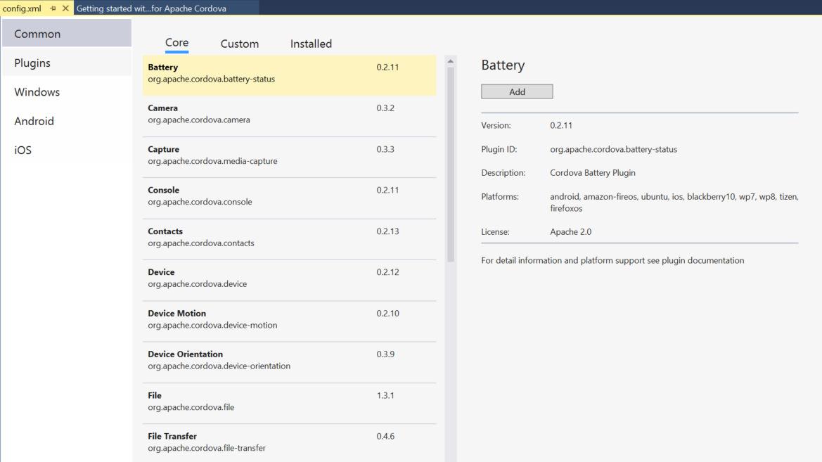
Adding a Plugin
Notes:
Standard plugins
Adding custom plugins
Creating a new plugin
I Haz Cheeseburger?!?!” message Ripple

Slide 23
Demo 3 : Network Plugin

Slide 24
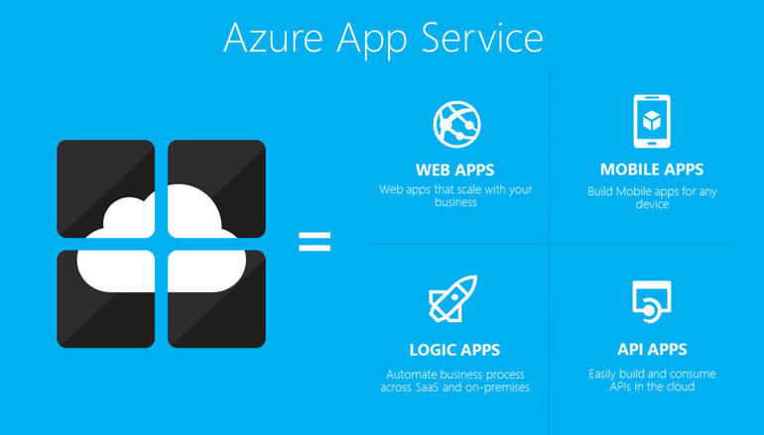
Connecting to Azure

Slide 25
Demo 4 : Connecting to Azure
Notes:
The long list problem

Slide 26
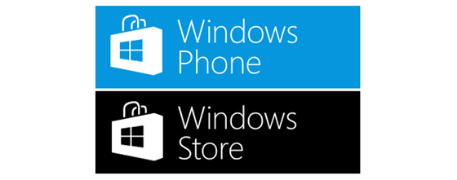
Deploying Your Application

Slide 27
Deploying Your Application
Install Xcode and command line tools
Install Node.js
Install signing certificate
In a terminal window install remotebuild (was vs-mda-remote)
sudo npm install -g remotebuild
Start remote agent
remotebuild [–secure false]
Set pin in Visual Studio
Notes:
New pin vs-mda-remote generateClientCert
Ctrl-C stop

Slide 28
Demo 5 : Deploying Your Application

Slide 29
Takeaways
Can code for many devices with one code base
Takes work to get user experience right for the device
Click Vs. Touch
OS and Version Differences
Lots of UI Frameworks out there
For iOS there needs to be a Mac somewhere
Plugins can allow you to access device features and handle CPU intensive tasks

Slide 30
Thanks!!!
Kevin Ford
Twitter: @Bowman74
kevinf@magenic.com
http://windingroadway.blogspot.com

